Slide 1
COURSE CODE:
INFT 352
TITLE:
Advanced Web Engineering and Application With PHP
LECTURER/ INSTRUCTOR: P.M SARFO

Slide 2
Basic Form Handling Web App (Part 1 - Input & Validation)

Slide 3
Form
Forms are crucial when developing web applications that require interactive input from the user
You always interact with a form whenever you login into your mailbox or any website.
These forms are used to get input from the user and submit it to the web server for processing.
A form is an HTML that consists of graphical user interface items such as input boxes, check boxes, radio buttons, etc.

Slide 4
HTML Forms contains elements such as buttons, text boxes, pop-ups, check boxes, etc.
Simple HTML construct using these elements for user input
Submits information via POST method as key-value pairs in body of request
POST is better method to send data as GET has max of 256 characters

Slide 5
Create a form
Using HTML tags to create a form. A minimum list of things needed to create a form is mentioned below.
<form>…</form> are Opening and closing form tags
POST or GET – Form submission type
Submission URL to process the submitted data
Input fields like input boxes, text areas, buttons, checkboxes, etc.

Slide 6
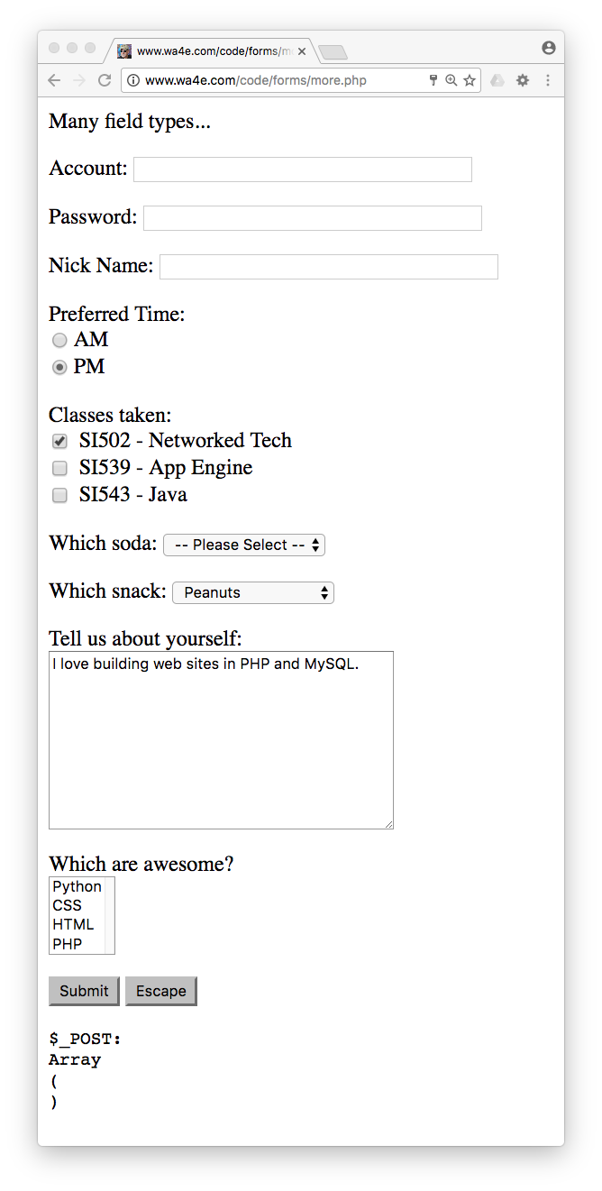
Form Input Types
Text
Password
Radio Button
Check Box
Select / Drop-Down
Textarea

Slide 7
Creating HTML and PHP on the same File and Displaying the results on the same page

Slide 8
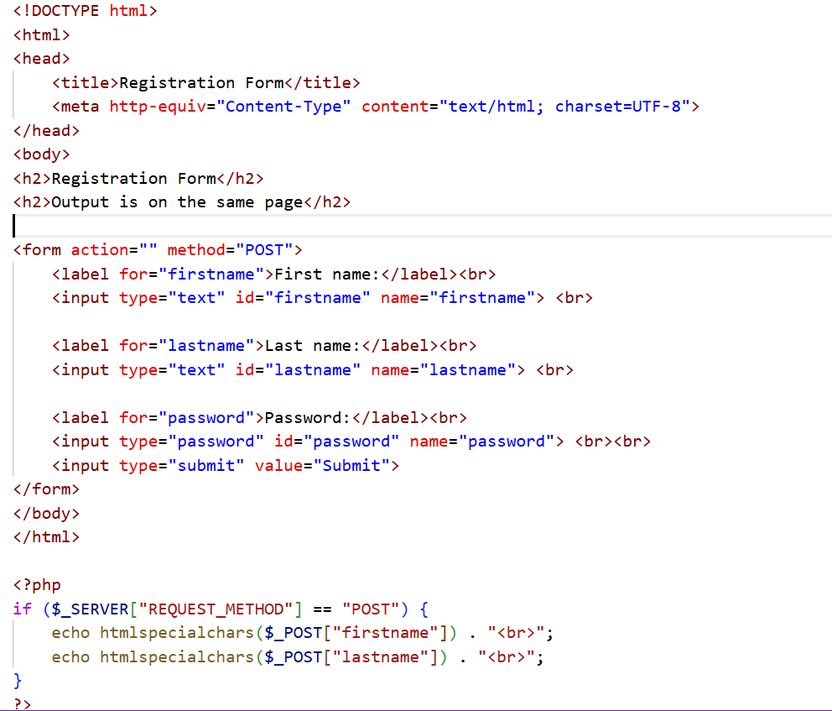

Slide 9
Creating two separate HTML and PHP Files and Displaying the results on a different page.

Slide 10
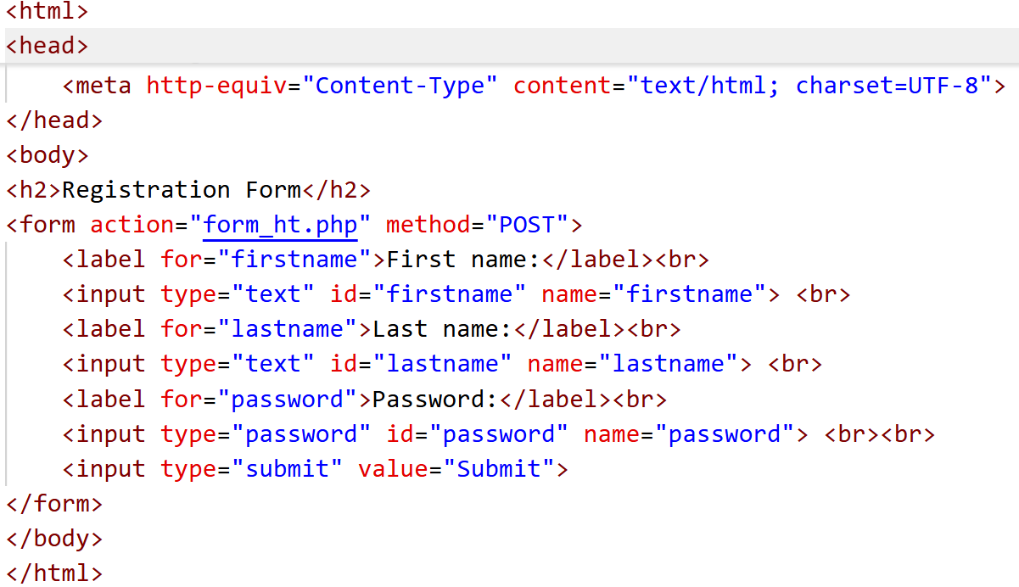
Create HTML FORM

Slide 11
When the user fills out the form above and clicks the submit button, the form data is sent for processing to a PHP file named “form_ht.php".
The form data is sent with the HTTP POST method.
To display the submitted data you could simply echo all the variables.

Slide 12
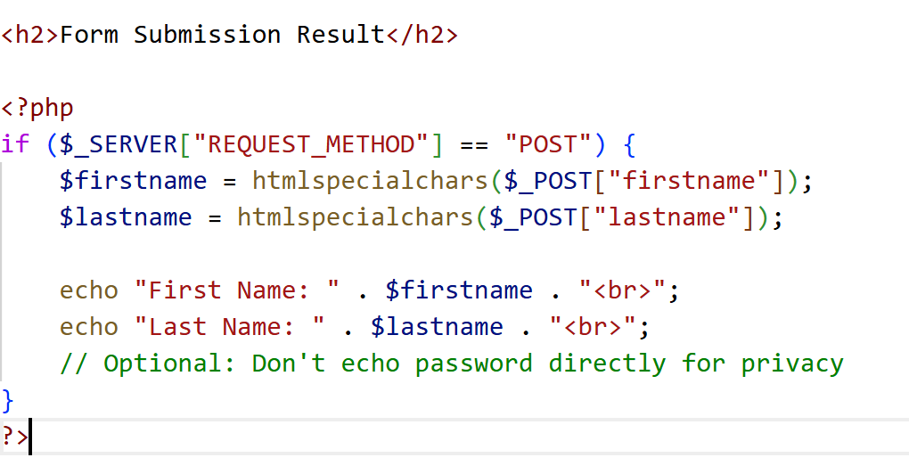
Create a PHP file

Slide 13
GET and POST Methods in PHP
There are two methods through which a browser can send information to the Server. Methods are given below.
GET method
POST method
These methods are the HTTP request methods that are used to send form data to the server inside the <form>tag.
This protocol enables communication between the client and the server where a browser can be the client, and an application running on a computer system that hosts your website can be the server.

Slide 14
GET METHOD
The GET method is required to submit the HTML form data. The data is collected by the predefined $_GET variable for processing.
All variable names and their values will be displayed in the URL since the data supplied from an HTML form using the GET method is visible to everyone in the browser’s address bar.
Therefore, the get method is not secure to send sensitive information.

Slide 15
POST METHOD
An HTML form data is submitted using the POST method, just like with the GET method.
However, instead of using $_GET to collect the data supplied by this method, the predefined superglobal variable $_POST is used.
It does not have a restriction on the amount of data that can be sent, in comparison to the GET technique.
Nobody can see the data submitted from an HTML form using the POST technique.

Slide 16
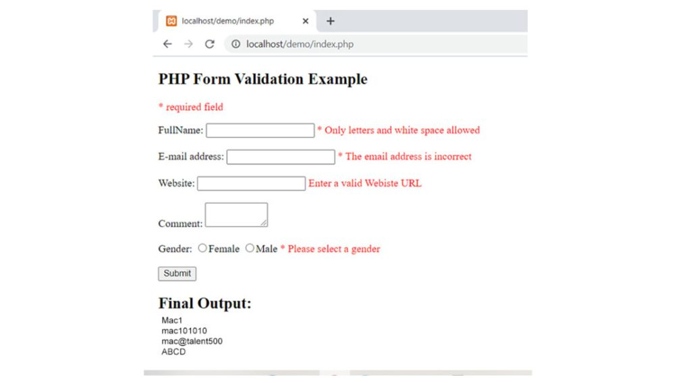
Form Validation

Slide 17
Form Validation refers to the process of ascertaining if the data entered by the user in various form elements is acceptable for further processing.
Form validation refers to the process of checking user inputs submitted through HTML forms to ensure they meet specific requirements before further processing.
Form validation is essential for securing applications, ensuring data accuracy, and providing meaningful feedback to users.
Validation of data before its subsequent processing avoids possible exceptions and runtime errors.

Slide 18
Why Form Validation is Important
Security: Prevents malicious inputs like XSS (Cross-site Scripting), SQL Injection, and other code injections.
Accuracy: Ensures only valid and expected data is stored or processed.
User Experience: Provides real-time feedback to guide users in filling out forms correctly.

Slide 19
Following are the rules for form validation
Required Fields: You need to make sure important fields are not empty.
Email Validation: You can check if the email address is valid or not.
Number Validation: You should allow only numbers for fields like age or phone number.
URL Validation: Need to check if a valid website URL is entered by the user.
Length Check: You have to limit how many characters a user can enter in the form.
Pattern Matching: You can also use regular expressions to allow only specific characters.

Slide 20
Types of Form Validation
Validation can be done both on the client-side and on the server-side.
When the client submits the form, the form data is intercepted by the PHP script running on the server.
Using various functions available in PHP, the server-side form validation can be done.

Slide 21
Client-side Validation: This happens in the user's web browser before the form submission. It provides instant feedback to users. This is commonly done with JavaScript.
Server-side Validation: After the submission of the form, server-side validation happens. It is important for security and ensures that data is checked on the server even when client-side validation is turned off.

Slide 22
How to Validate Forms in PHP
To validate forms in PHP you will have to follow the below steps −
Create a Form: First you need to create a simple HTML form.
Collect Form Data: Then use PHP to collect the data after the form is submitted.
Perform Validation: After that you have to check if the data meets specific criteria.
Provide Feedback: Inform the user if there are any errors or if the submission is successful.

Slide 23
Client-side Validation
The new input controls as per the HTML5 specifications have in-built validation.
For example an input element of the type 'email', even though is a text field, is customized to accept a string that is according to email address protocol.
Validation takes place before the data is submitted to the server. Same thing is true with other input types such as URL, number, etc.

Slide 24
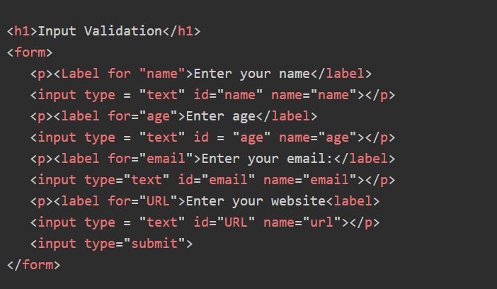
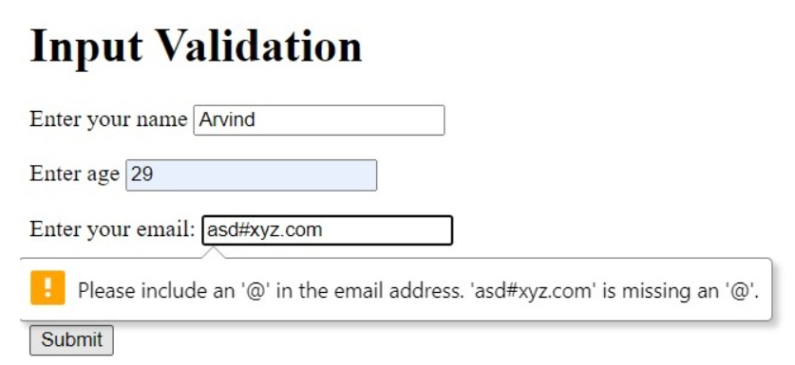
Client-side Validation

Slide 25
Server-Side Validation
The validation on the server-side with PHP comes into picture, either when the form data passes the client-side validation, or there's no validation on the client side at all.
Server-side validation means that form data is sent to the server, where PHP code checks whether it’s valid (e.g., required fields are filled, email is in the correct format, etc.).

Slide 26
Server-Side Validation
Two Common Approaches in PHP
Approach 1: Single File
The form and validation code are both in one file (e.g., form.php)
Uses $_SERVER["PHP_SELF"] as form action
Approach 2: Separate Files
One HTML file contains the form (form.html)
One PHP file processes/validates input (process.php)

Slide 27
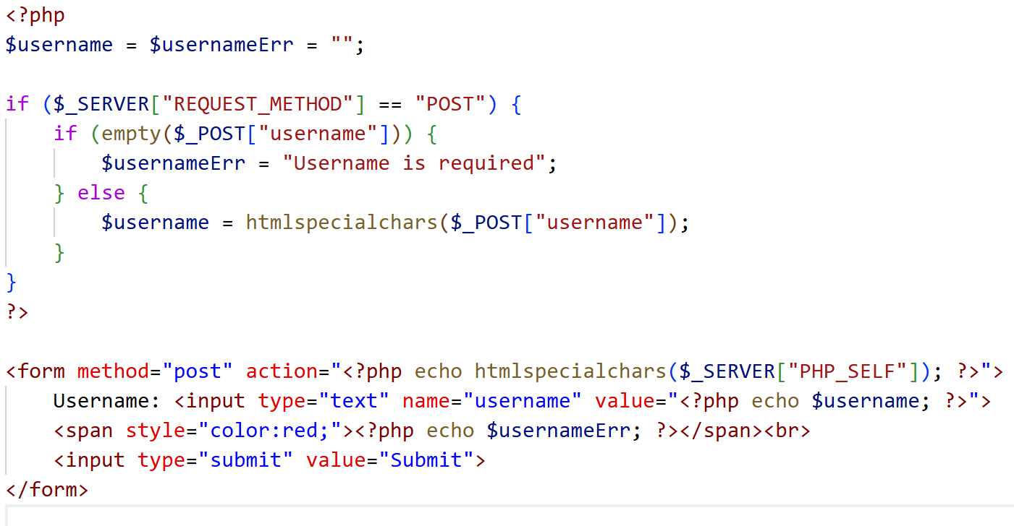
Approach 1: Single File

Slide 28
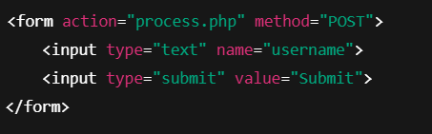
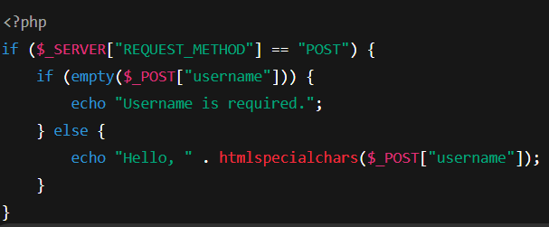
Approach 2: Separate Files
form.html
process.php

Slide 29
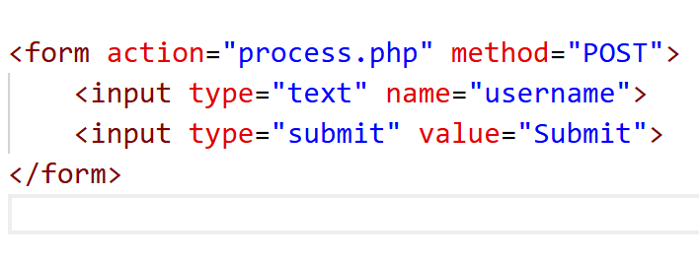
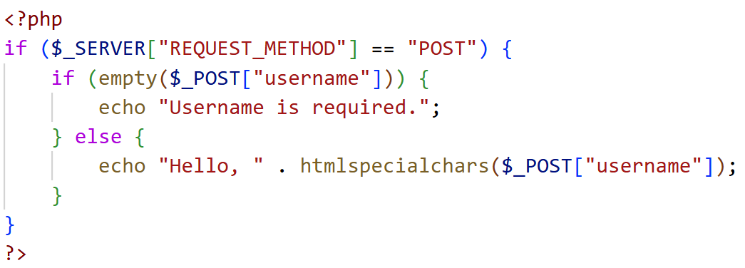
Approach 2: Separate Files
form.html
process.php

Slide 30
THANK YOU
Program - level
Name - index number
30

